Slide 1
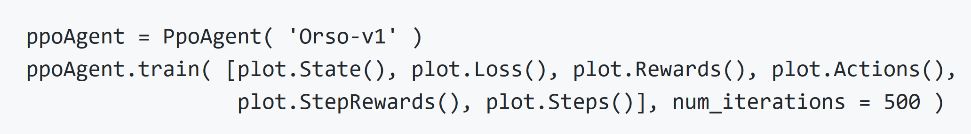
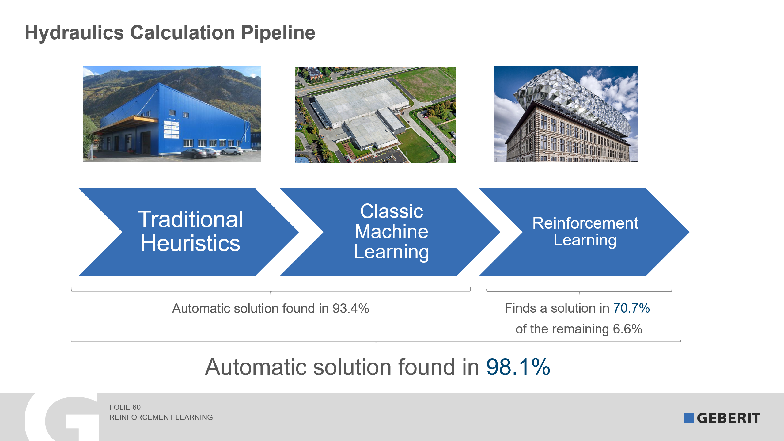
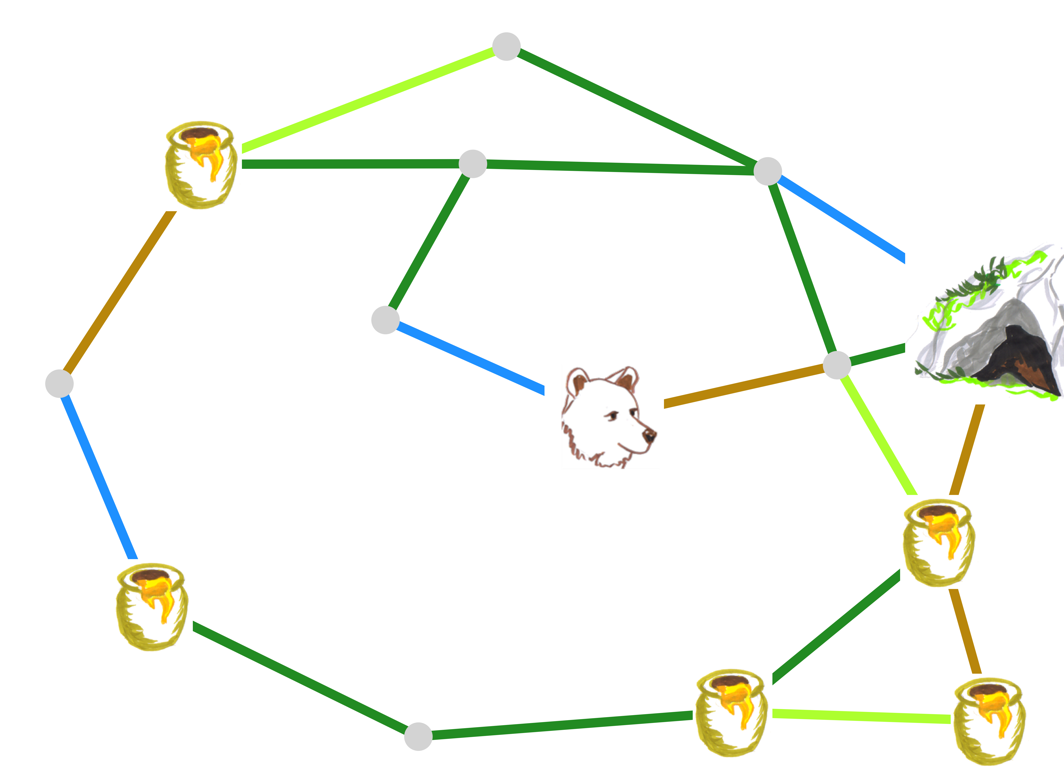
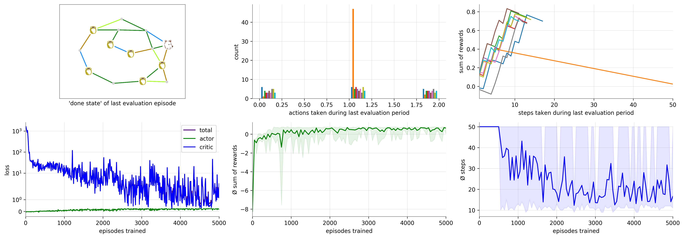
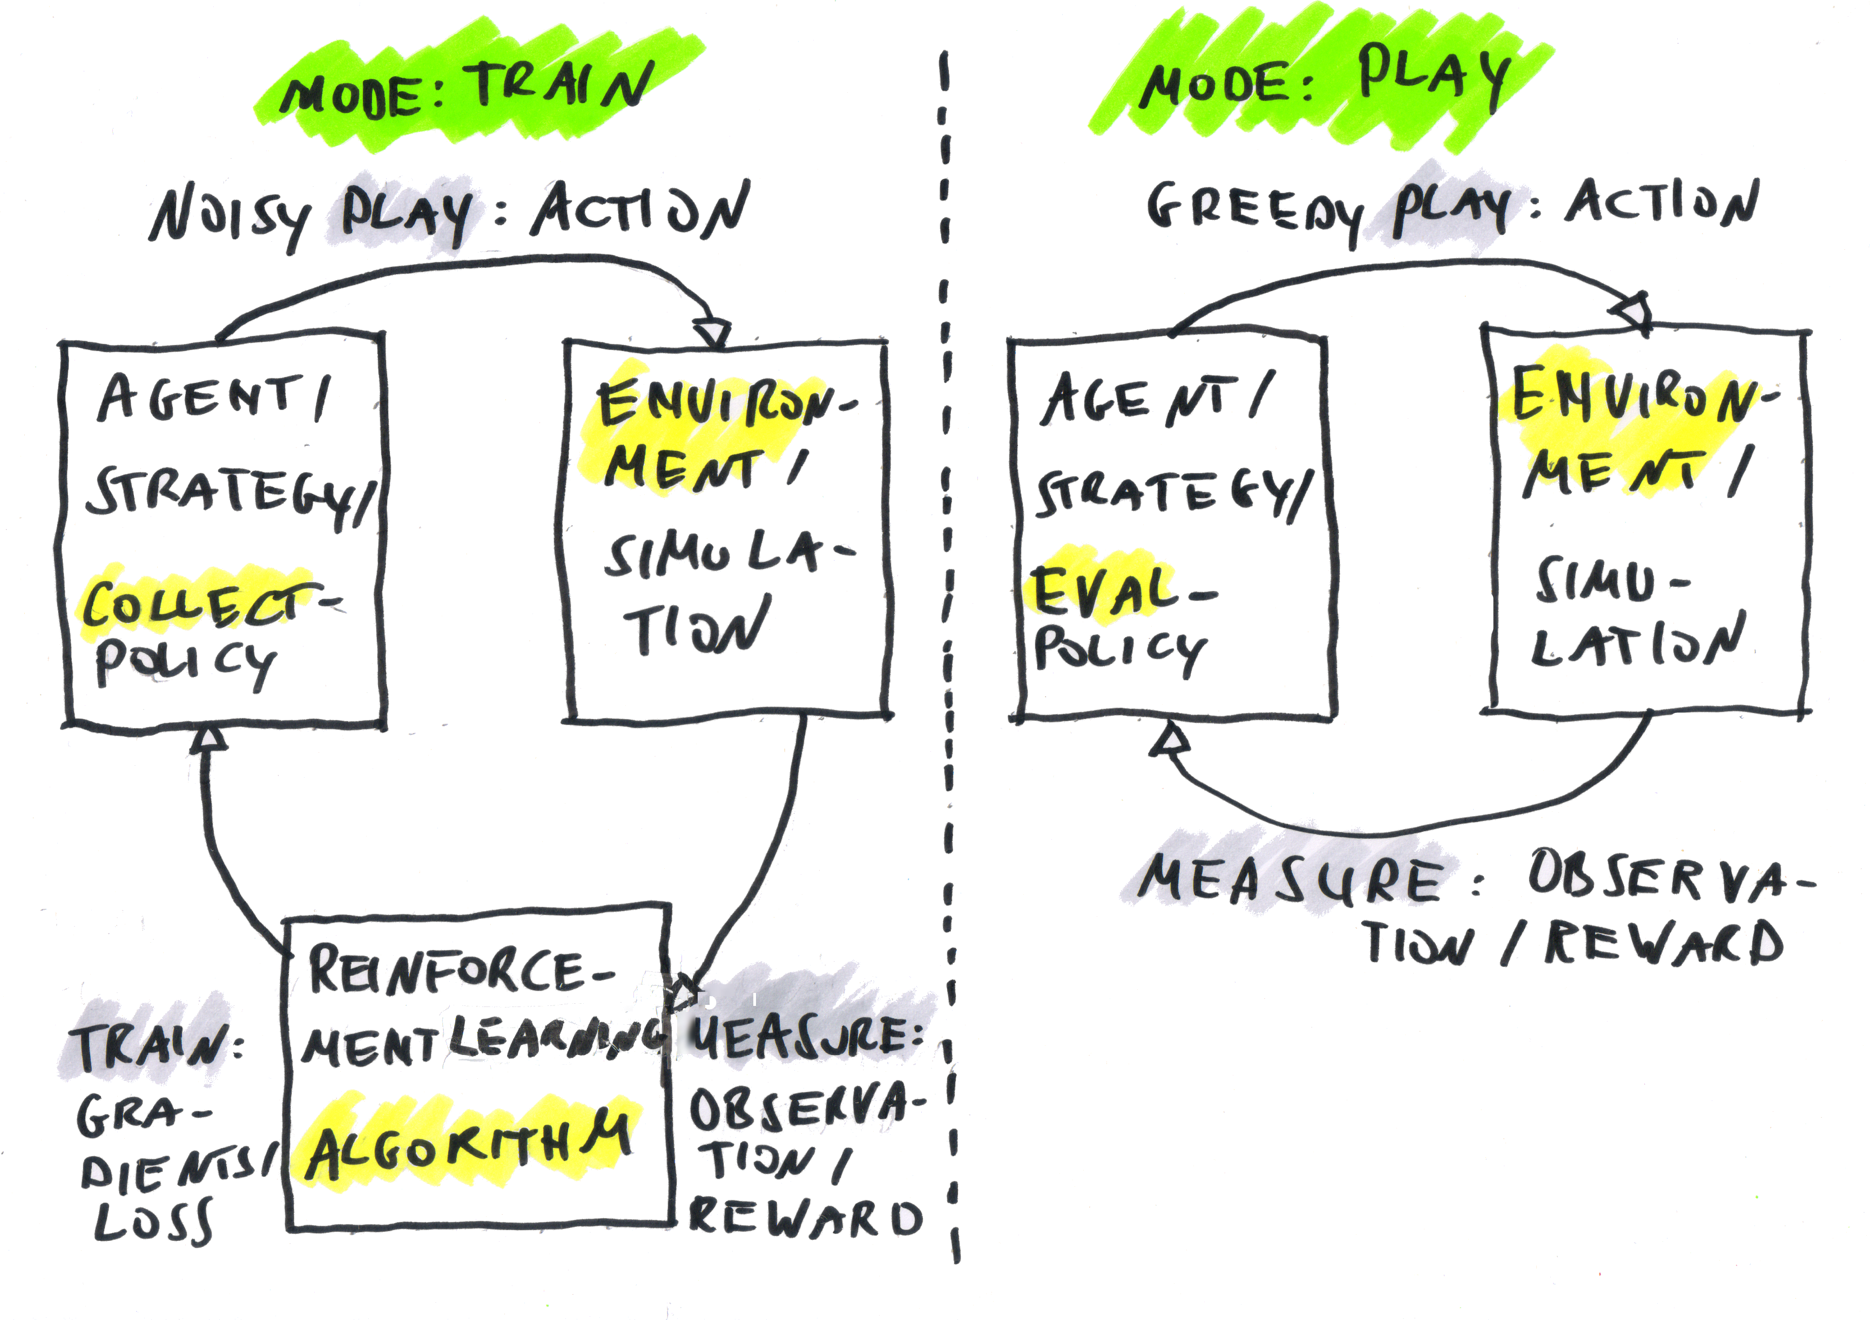
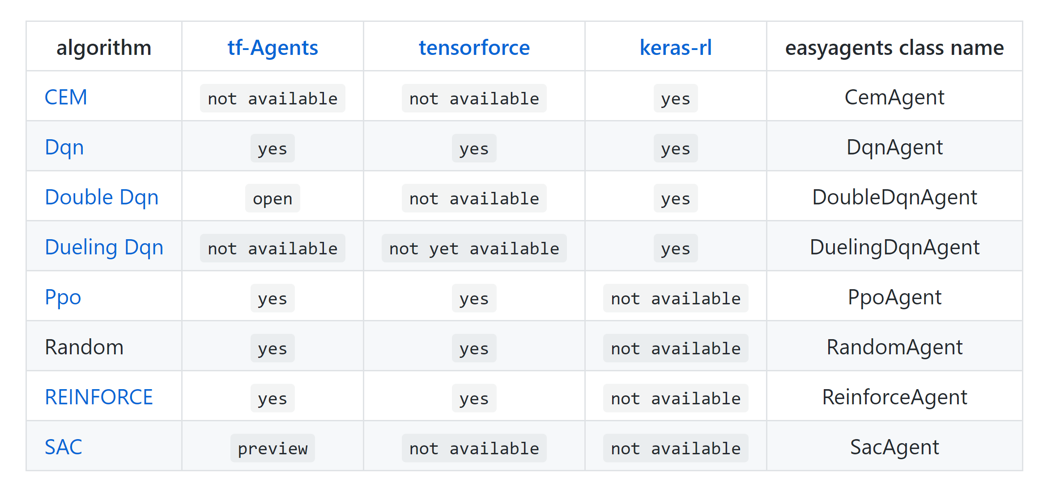
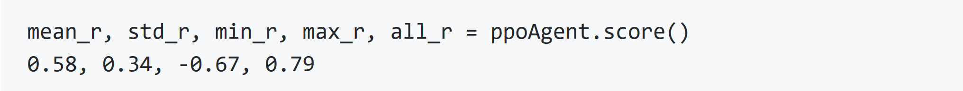
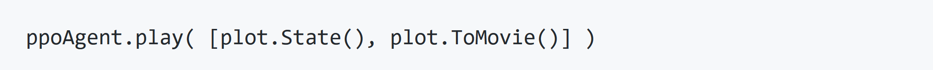
Scaling Down – Squaring Deep Neural Networks Oliver Zeigermann, http://scaledml.org/2020/
Reinforcement Learning - Bears have problems too
Our bear Orso lives in his cave and each morning tries to get to all the honey with the least amount of effort possible.
Reinforcement Learning finds the best strategy for our lazy bear
Simplified API and Plots
Environments are defined with OpenAI gym and can be used for training with a few lines of code. You can choose from a variety of learning algorithms
A configurable set of dynamic plot shows the progress of the training at any time
Once training has finished a simple score method will inform you of the performance of the trained policy
And finally you can use your trained policy to solve the bears daily changing chores and get a movie of the steps taken:
Industrial Applications
Geberit uses EasyAgents to solve the hydraulics control problem for syphonic roof drainage systems (no feasable deterministic algorithm is known):
Plugable Backends
EasyAgents is an abstraction layer over other more low-level reinforcement learning libraries, like Keras is for low-level TensorFlow.
Notebook: http://bit.ly/scaling-down-2020

